Slide 1
HTML FORM

Slide 2
When automating any manual process, converting paper forms to their web equivalence is one of the important tasks you need to do.
HTML forms are required if you want to collect some data from of the site visitor.
Website forms are an essential part of any website that requires user interaction as it is used in capturing data from the users; It facilitates dynamic contents on your webapp.
The form is created with the form tag as follows: <form></form>
Example, after you complete filling any form in the bank, what happens next? You submit it to the customer service officer for processing.
Likewise, web form has a submit button to send the contents of the form to an action page for processing

Slide 3
The <input> Element
The HTML <input> element is the most used form element.
An <input> element can be displayed in many ways, depending on the type attribute.
Here are some examples:
Type Description
<input type="text"> Displays a single-line text input field
<input type="radio"> Displays a radio button (for selecting one of many choices)
<input type="checkbox"> Displays a checkbox (for selecting zero or more of many choices)
<input type="submit"> Displays a submit button (for submitting the form)
<input type="button"> Displays a clickable button.

Slide 4
<input> Element Attributes
    Some attributes of the input text field are: size which determines the width and the number of characters it can take respectively. Required attribute helps with browser validation. Placeholder which specifies a short hint that describes the expected value of an input field. min and max: specify the minimum and maximum values for an input field. Readonly which only allows you to read but not editable.
The type attribute determines the function of the input tag , when not specified, it defaults to text (defines a single-line text input field. )
Other type values are: number, text, password, search, email, color, date, file.

Slide 5
OTHER HTML5 INPUT TYPES
<input type="color">
<input type="date">
<input type="datetime-local">
<input type="email">
<input type="hidden">
<input type="image">
<input type="month">
<input type="number">
<input type="password">
<input type="range">
<input type="search">
<input type="submit">
<input type="tel">
<input type="text">
<input type="time">
<input type="url">
<input type="week">
The <input type="range"> defines a control for entering a number whose exact value is not important (like a slider control). Default range is 0 to 100. However, you can set restrictions on what numbers are accepted with the min, max, and step attributes
The type = url, email and the above restrictions automatically helps you validate the input field when submitting the form

Slide 6
The <datalist> Element
Example
  <form action=“#">
  <input list="browse">
  <datalist id=“browse">
  <option value="Edge">
  <option value="Firefox">
  <option value="Chrome">
  <option value="Opera">
  <option value="Safari">
  </datalist>
  </form>
The <datalist> element specifies a list of pre-defined options for an <input> element.
Users will see a drop-down list of the pre-defined options as they input data. The list attribute of the <input> element, must refer to the id attribute of the <datalist> element.

Slide 7
The <label> Element
Form elements should be labelled to guide the user on the expected input data. The label tag is used for this purpose.
Syntax is <label for=“your-id”>Fullname</label>
The label tag can have an attribute “for” which binds the label to the form element through its id attribute to help screen readers in proper identification
Clicking a label triggers the focus event for the bound input. Interesting thing is that, if it is a file input, it results in opening a file browser.
<label for="email">Email</label>
<input type="text" name="email" id='email'>
Note: The for attribute of the <label> tag should be equal to the id attribute of the <input> element to bind them together.

Slide 8
Some HTML Form Attributes
The Name Attribute for <input>
Notice that each input field must have a name attribute to be submitted. Note: If the name attribute is omitted, the value of the input field will not be sent at all.
The Action Attribute
The action attribute defines the action to be performed when the form is submitted. Usually, the form data is sent to a file on the server when the user clicks on the submit button.
The Target Attribute
The target attribute specifies where to display the response that is received after submitting the form. The target attribute can have one of the following values: _parent, _self, _blank, _top
The Method Attribute
The method attribute specifies the HTTP method to be used when submitting the form data. The form-data can be sent as URL variables (with method="get") or as HTTP post transaction (with method="post"). The default HTTP method when submitting form data is GET.
The Autocomplete Attribute
The autocomplete attribute specifies whether a form should have autocomplete on or off. When autocomplete is on, the browser automatically complete values based on values that the user has entered before.

Slide 9
Input Restrictions
Here is a list of some common input restrictions:
Attribute Description
disabled Specifies that an input field should be disabled
max Specifies the maximum value for an input field
Maxlength Specifies the maximum number of character for an input field
min Specifies the minimum value for an input field
pattern Specifies a regular expression to check the input value against
readonly Specifies that an input field is read only (cannot be changed)
required Specifies that an input field is required (must be filled out)
size Specifies the width (in characters) of an input field
step Specifies the legal number intervals for an input field
value Specifies the default value for an input field
checked Specifies that an input field should be pre-selected when the page loads (for type="checkbox" or type="radio")

Slide 10
THE RADIO BUTTON
<input type="radio"> defines a radio button.
It is typically used to select ONLY ONE of a limited number of choices. This is achieved by using the same name attribute for all the radio buttons:
The value attribute is important on a radio button since the user is expected to select from an existing range of options (pre-determined values)

Slide 11
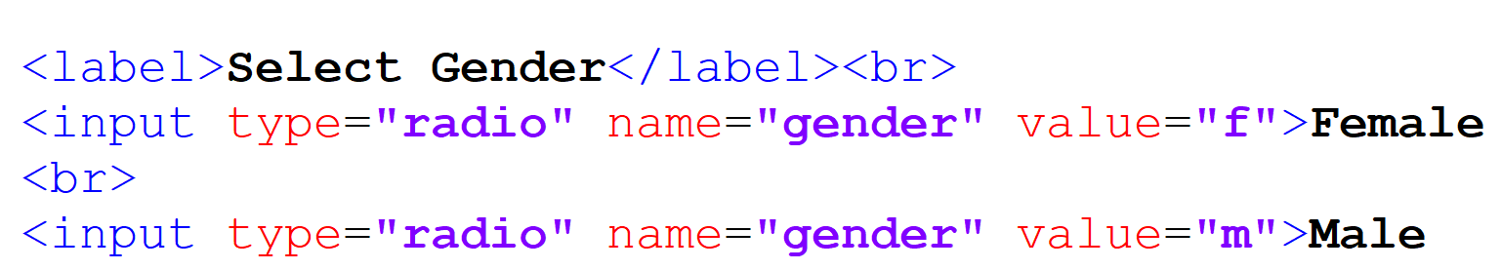
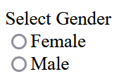
SELECTING USING THE RADIO INPUT

Slide 12
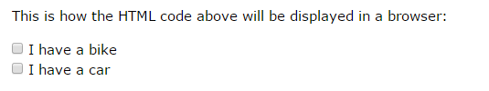
INPUT TYPE CHECKBOX
<input type="checkbox"> defines a checkbox.
Checkboxes let a user select ZERO or MORE options of a limited number of choices.
The value of a checkbox defines what is submitted
<form>
<input type="checkbox" id="vehicle1" name="vehicle1" value="Bike">
<label for="vehicle1"> I have a bike</label><br>
<input type="checkbox" id="vehicle2" name="vehicle2" value="Car">
<label for="vehicle2"> I have a car</label><br>
</form>

Slide 13
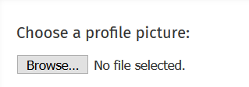
Input type file
<input> elements with type="file" lets the user choose one or more files from their device storage. Once chosen, the files can be uploaded to a server using some file manipulations (server side or client side)
The tag can optionally have a boolean attribute, 'multiple' to allow the user enter more than one value in the <input> element

Slide 14
TEXETAREA
The <textarea> tag defines a multi-line text input control.
The <textarea> element is often used in a form, to collect user inputs like comments or reviews.
The size of a text area is specified by the cols and rows attributes
Example: <textarea name="message" rows="10" cols="30"></textarea>
To stop the textarea from resizing, you can define the style property/value.
  style="resize:none"

Slide 15
HTML Input tag “Button” type
HTML 5 Supports the <button> tag.
      <button> Submit </button>
It has an attribute type which tells the type of button it is: button, submit and reset
If the type attribute is not specified, the default is submit.
<button type="button" onclick="alert('Hello World!')">Click Me!</button>
The Submit Button
<input type="submit"> defines a button for submitting the form data to a form-handler.
The Reset Button
<input type=“reset"> defines a button for clearing the form.

Slide 16
Some common input restrictions:
Attribute | Description
checked | Specifies that an input field should be pre-selected when the page loads (for type="checkbox" or type="radio")
disabled | Specifies that an input field should be disabled
max | Specifies the maximum value for an input field
maxlength | Specifies the maximum number of character for an input field
min | Specifies the minimum value for an input field
value | Specifies the default value for an input field
readonly | Specifies that an input field is read only (cannot be changed)
required | Specifies that an input field is required (must be filled out)
size | Specifies the width (in characters) of an input field

Slide 17
SELECT DROPDOWN
Use the size attribute to specify the number of visible values:
Example:
<label for="cars">Choose a car:</label>
<select id="cars" name="cars" size="3">
<option value="volvo">Volvo</option>
<option value="saab">Saab</option>
<option value="fiat">Fiat</option>
<option value="audi">Audi</option>
</select>
The basic select drop down is used to collect users input choosing one options out of many options presented with option tag
NOTE: The option tag must be within a select tag (See the notes for more)
<select name=“country”>
  <option value=“Nigeria”>Nigeria</option>
  <option value=“Ghana”>Ghana</option>
  <option value=“Senegal”>Senegal</option>
  <option value=“Gambia”>Gambia</option>
  </select>

Slide 18
Class Work:
Create a form that has an image at the top and a place where the image can be changed. Let the form have relevant inputs to capture name, surname, email, password, where to select state among 5 states in Nigeria, and a gender select. The input should have asterisk for compulsory fields. There should be a checkbox for agree to terms and condition and a button to submit at the end

Slide 19
HTML FORM WITH fieldset and legend.
HTML <fieldset> </fieldset> tag is used to group the logically related fields/labels contained within an HTML form.
HTML <legend> </legend> tag is used to insert a title or caption to its parent element such as <fieldset>. The <legend> element must be the first child of <fieldset > element.
The <legend> tag is used with the <fieldset> element as a first child to define the caption for the grouped related fields.
The use of the <filedset> and <legend> tag is optional while creating an HTML form but by using them, it is easy to understand the purpose of grouped elements of form.

Slide 20
<form>
<fieldset>
<legend>User Information:</legend>
<label for="name">Enter name</label><br>
<input type="text" id="name" name="name"><br>
<label for="pass">Enter Password</label><br>
<input type="Password" id="pass" name="pass"><br>
<input type="submit" value="submit">
</fieldset>
</form>

Slide 21
SUBMITTING FORM DATA
Within the form tag, create button tag as <button>Submit</button>
The form tag has 2 important attributes described below:
  action which defines where the form data will be sent to (destination page) when the form is submitted; If the action attribute is omitted, the action is set to the current page.
  method which specifies the means of transporting the data to the destination. It can have value GET or POST. When not specified, it defaults to “GET”

Slide 22
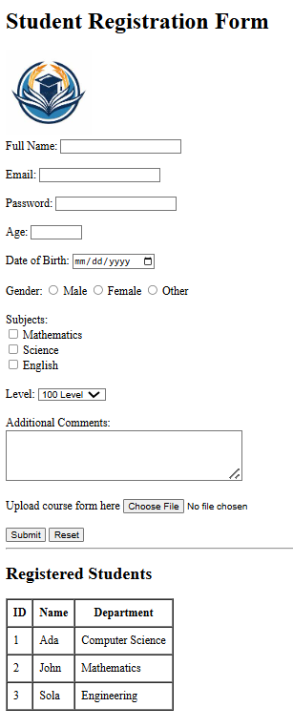
ASSIGNMENT

Slide 23
MULTIMEDIA

Slide 24
HMTL MULTIMEDIA
Audio tag
Video tag

Slide 25
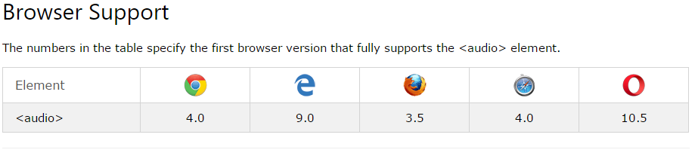
Audio on web
The HTML5 <audio> element specifies a standard way to embed audio in a web page. Similar to the img tag, its syntax is :
<audio controls src="media/birds.mp3"></audio>

Slide 26
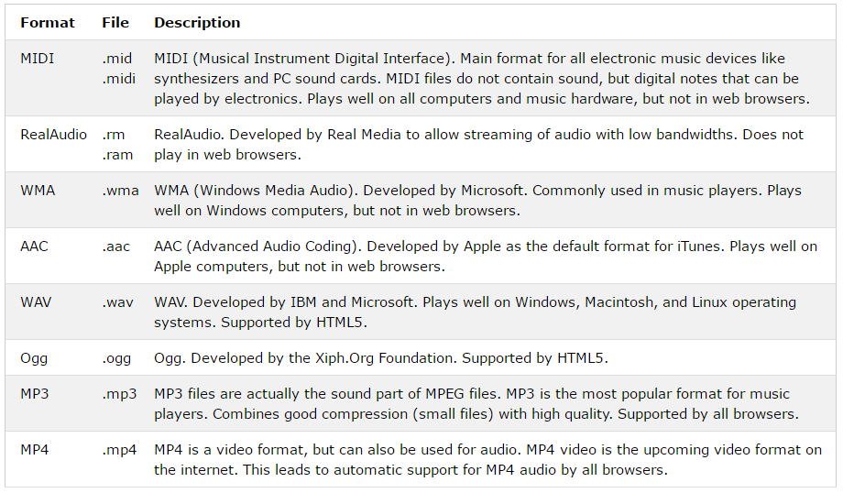
MULTIMEDIA FILE FORMATS

Slide 27
<audio controls>
<source src="myAudio.ogg" type="audio/ogg" />
<source src="myAudio.mp3" type="audio/mp3" />
<source src="myAudio.wav" type="audio/wav" />
Your browser does not support the audio tag
</audio>
To download some free short audio and videos
https://pixabay.com/sound-effects/search/short/
https://www.freepik.com/videos/short
The browser will attempt to play the ogg version and then play the mp3 version if it can not play the ogg format
But if the browser can not play any of the audio files, it will display the message on your browser
The text between the <audio> and </audio> tags will only be displayed in browsers that do not support the <audio> element

